Slide 1
Multi-Price Ecommerce
Website

Slide 2
Team Members :
Yogesh Kadam
Pratik Pidkalwar
Rushikesh Dhanwate
Shubham Handge
Sagar Kawale
Piyush Barhate

Slide 3



Technologies and Lead :
Frontend -Yogesh Kadam
-Shubham Handge
Backend -Rushikesh Dhanwate
-Sagar Kawale
Database -Pratik Pidkalwar
-Piyush Barhate

Slide 4
Introduction
Welcome to the unveiling of our groundbreaking project, "Revolutionizing E-Commerce Excellence." In an era where digital landscapes are transforming the way we conduct business, our team has embarked on a journey to redefine the online shopping experience. This project aims to introduce cutting-edge technologies, innovative solutions, and an enhanced user interface to establish a new standard in the world of e-commerce.

Slide 5
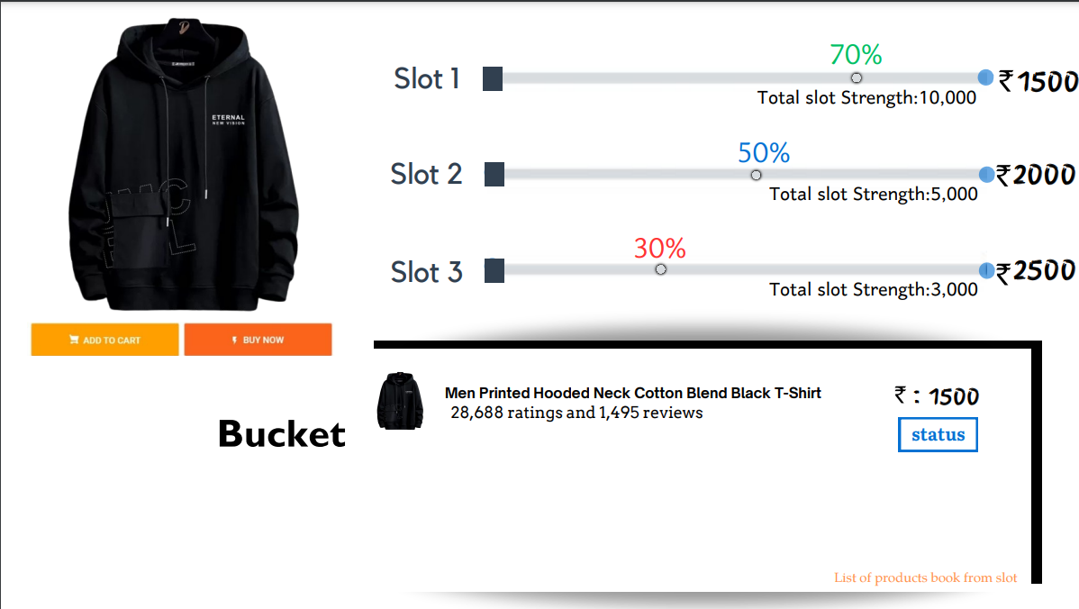
What is New ?

Slide 6
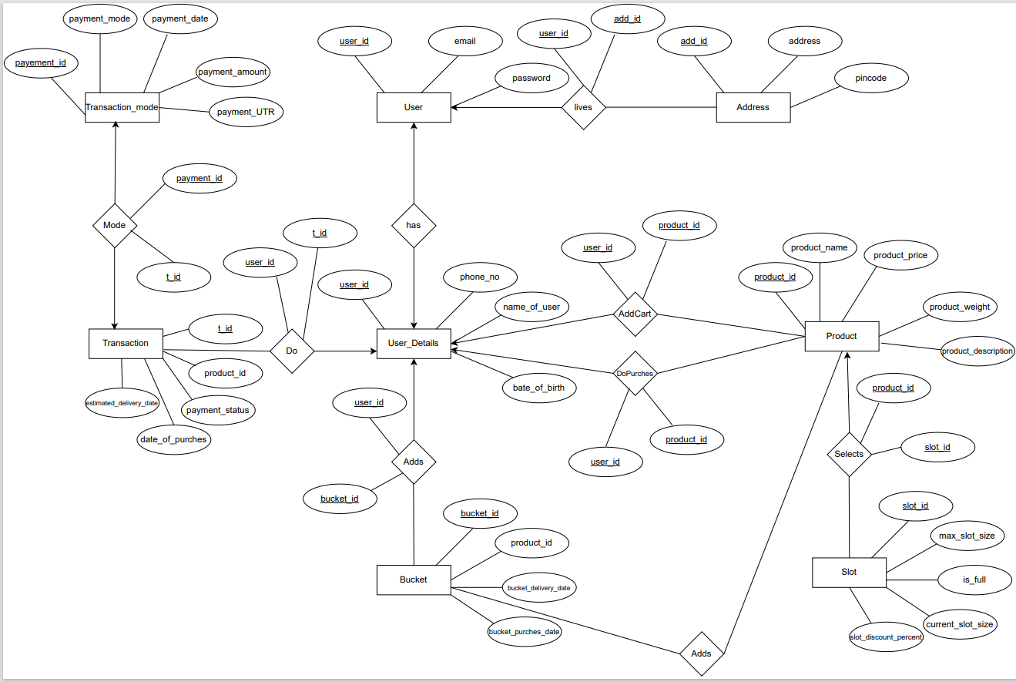
Entity Relationship Diagram
ER-Diagram

Slide 7
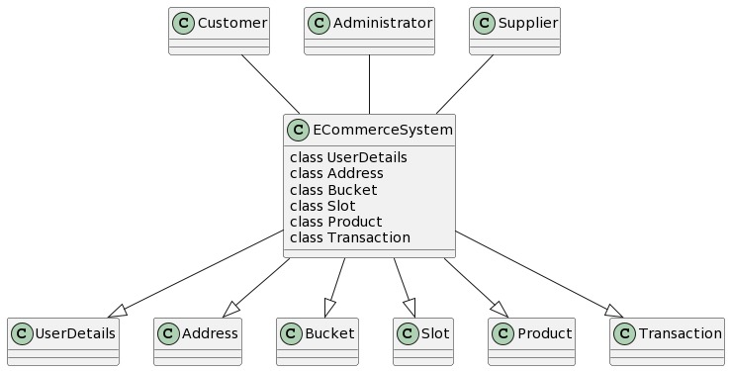
Data Flow Diagram

Slide 8


